Slide 1
Sensory Details
How to SHOW rather than tell...

Slide 2
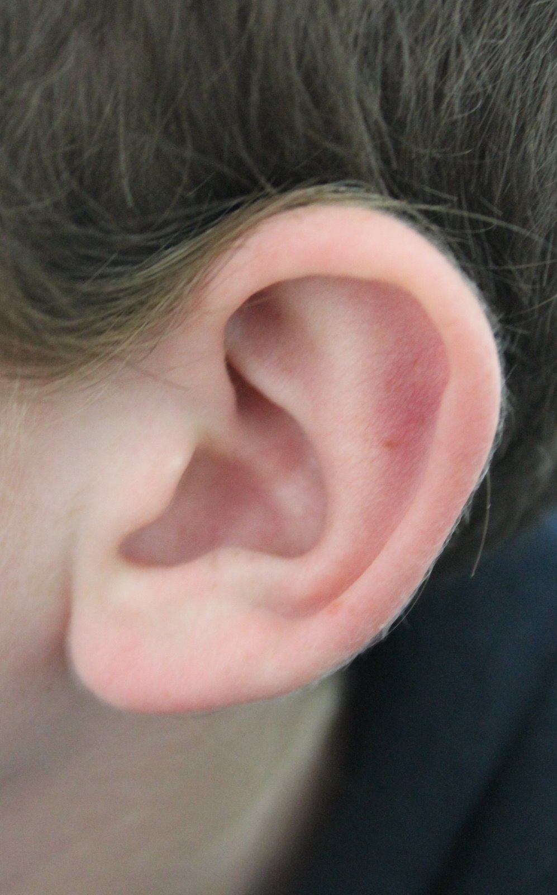
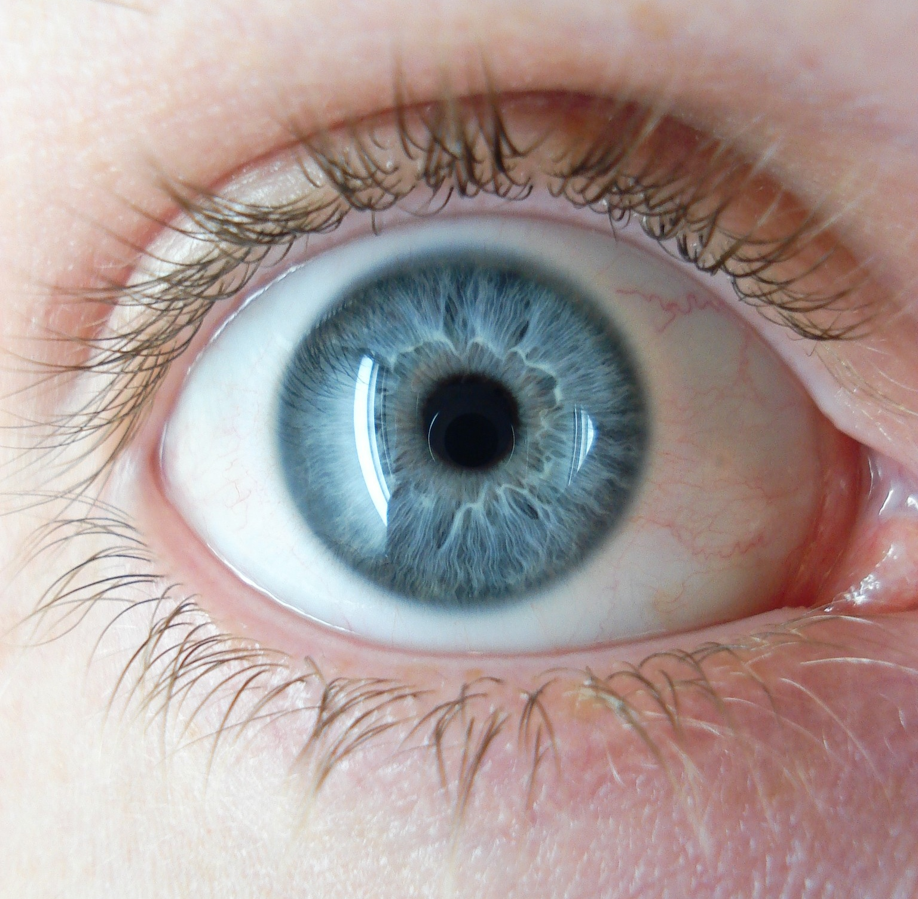
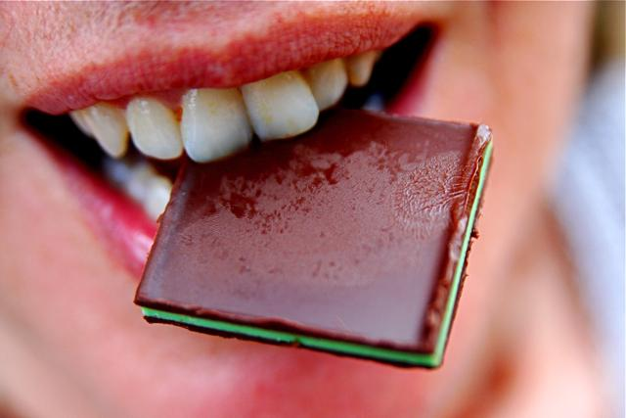
What are they?
Sensory details are bits of information that you collect through your five senses.

Slide 3
Why use sensory details?
When you elaborate with sensory details, you give the reader a much clearer idea of what you are describing.

Slide 4
Sensory details are often used to set the mood of a piece of writing.
Exciting Gloomy Suspenseful
Happy Frightening Calm
Cheerful Depressing Peaceful

Slide 5
EXAMPLE--Rather than this...
Prompt: Describe a place you enjoying going to.
I like to go to the beach. There is a lot of sand and even some trees there. People play games on the beach, and some people like to swim. I used to go to the beach very often.

Slide 6
EXAMPLE-- Do This instead!
One place I enjoy going to is where the land and the ocean meet. This beautiful spot is my sanctuary in the sun—and I choose it very carefully. I look for a cool place under the trees and extend my mat on the white sand. The wind that blows through the trees often carries a light sprinkle from the ocean, and a hint of saltiness. Peace consumes me whenever I see that beautiful white sand. Mixed with the calming sound of the waves hitting the rocks in the distance, are giggles from the children building castles. Here is where happiness lies, with its toes in the sand right beside me.

Slide 7
ACTIVITY
1. Turn desk so you are facing the person next to you. Make sure desks touching. Group of four.
2. Each group will get a bag with an object.
3. Touch it, feel it, etc…. BUT DO NOT TAKE IT OUT OF THE BAG-- only you and your partner should know the object.

Slide 8
Activity
4. Now write a long, well-written paragraph describing the object WITHOUT naming what the object is. Use enough details so that a stranger could read your paragraph and guess what the object is.
5. Use at least THREE of the five senses. Underline the sentences that appeal to a sense and label it!

Slide 9
How can I use all five senses?
Describe the object with as much detail as possible.
Who uses the object? What are they like? What do they feel like when they use it?
Where is the object typically used? Under what conditions?

Slide 10
Example:
Though I come in various sizes, I can almost always be carried easily. You could carry me to the beach, you could take me on a roadtrip, or even just to your couch. Sometimes I smell like new, but other times I smell dank and old. My smooth surface may have words and color galore, but I could be as simple as black and white. If you bring me outside, my insides may flutter with the wind, the rippling sound of cut up trees waving as they are tickled by the breeze. I am used by people, but I’m sure one of my kind has been chewed by a dog at some point in my existence. Although some people may think I am going instinct, I will last forever in the homes of many. When you grow up, your children may ask for me each night as a sleeping aid. What am I?

